Slide 1
Introduction to C++ Programming, Input/Output and Operators
Chapter 2 of C++ How to Program, 10/e

Slide 2
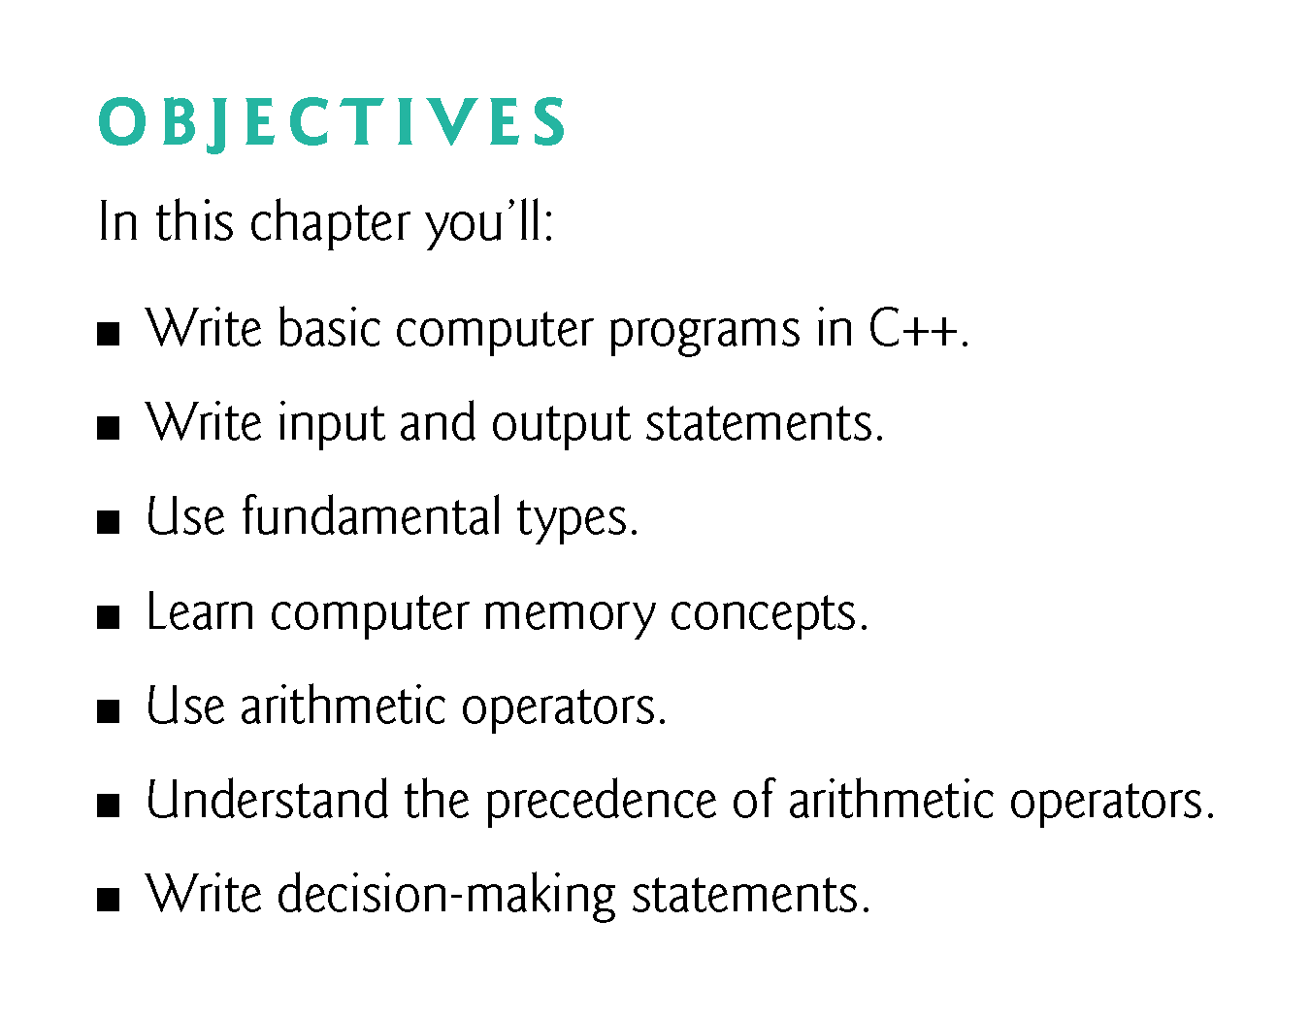

Slide 3
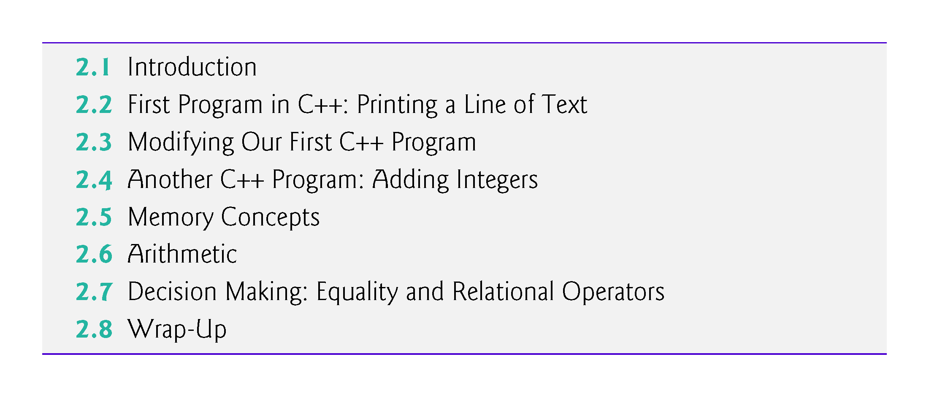

Slide 4
2.5 Memory Concepts
Variable names such as number1, number2 and sum actually correspond to locations in the computer’s memory.
Every variable has a name, a type, a size and a value.
When a value is placed in a memory location, the value overwrites the previous value in that location; thus, placing a new value into a memory location is said to be destructive.
When a value is read out of a memory location, the process is nondestructive.

Slide 5
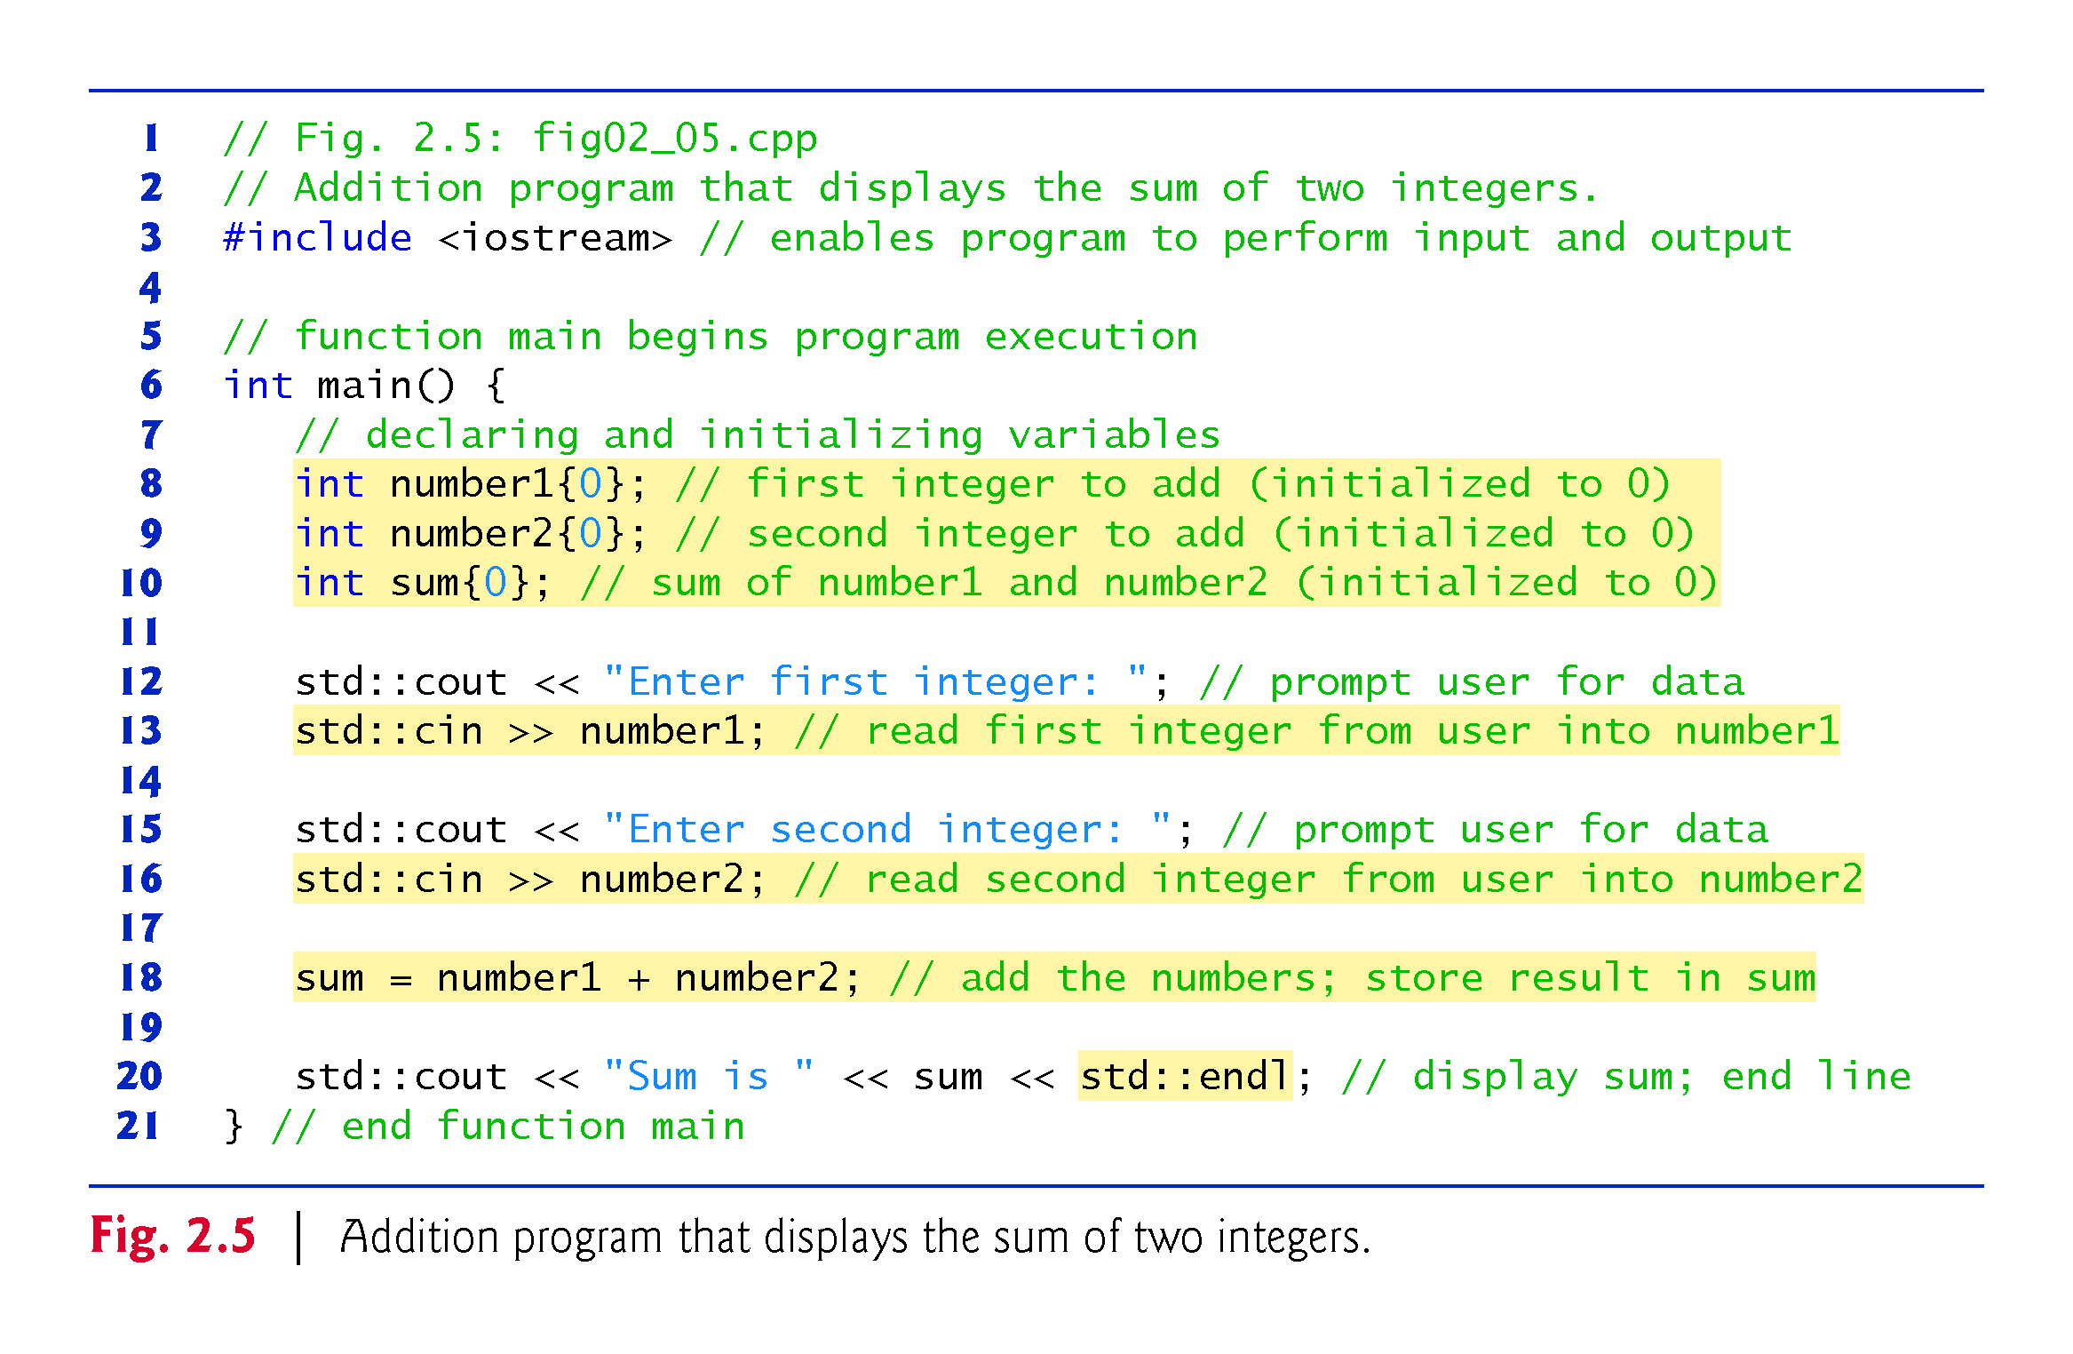

Slide 6
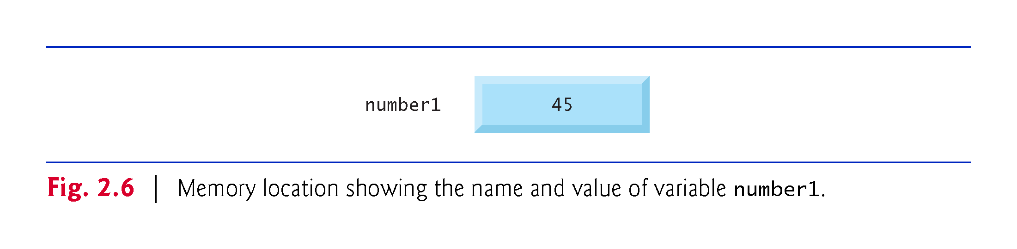

Slide 7
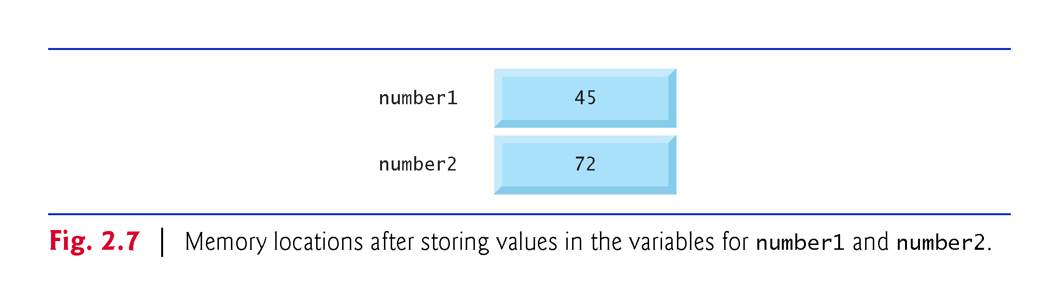

Slide 8
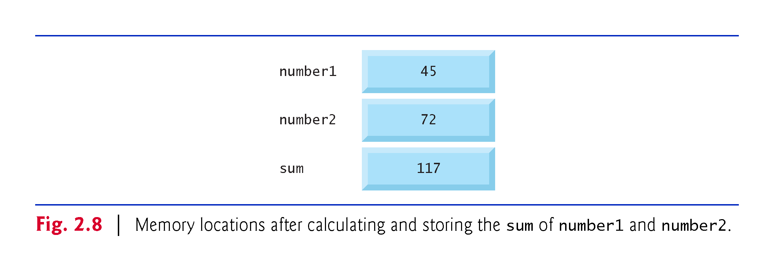

Slide 9
2.6 Arithmetic
Most programs perform arithmetic calculations.
Figure 2.9 summarizes the C++ arithmetic operators.
The asterisk (*) indicates multiplication.
The percent sign (%) is the remainder operator.
Yields the remainder after integer division.
Can be used only with integer operands.
The arithmetic operators are all binary operators.
Integer division (i.e., where both the numerator and the denominator are integers) yields an integer quotient.
Any fractional part in integer division is discarded (i.e., truncated)—no rounding occurs.

Slide 10
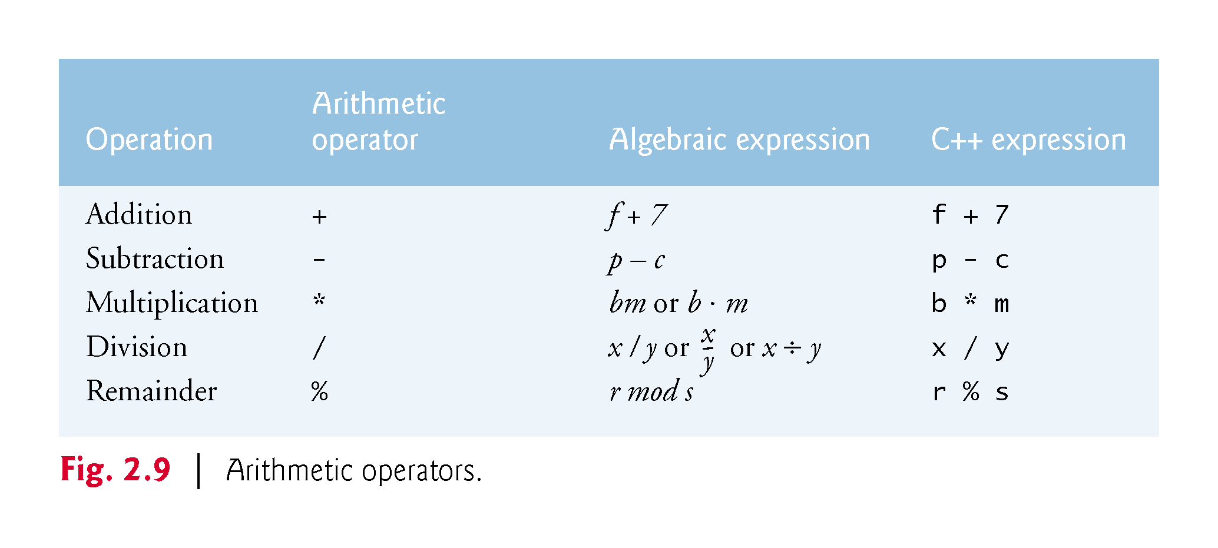

Slide 11
2.6 Arithmetic (cont.)
Arithmetic expressions in C++ must be entered into the computer in straight-line form.
Expressions such as “a divided by b” must be written as a / b, so that all constants, variables and operators appear in a straight line.
Parentheses are used in C++ expressions in the same manner as in algebraic expressions.
For example, to multiply a times the quantity b + c we write
a * ( b + c )

Slide 12
2.6 Arithmetic (cont.)
C++ applies the operators in arithmetic expressions in a precise sequence determined by the following rules of operator precedence, which are generally the same as those followed in algebra.

Slide 13
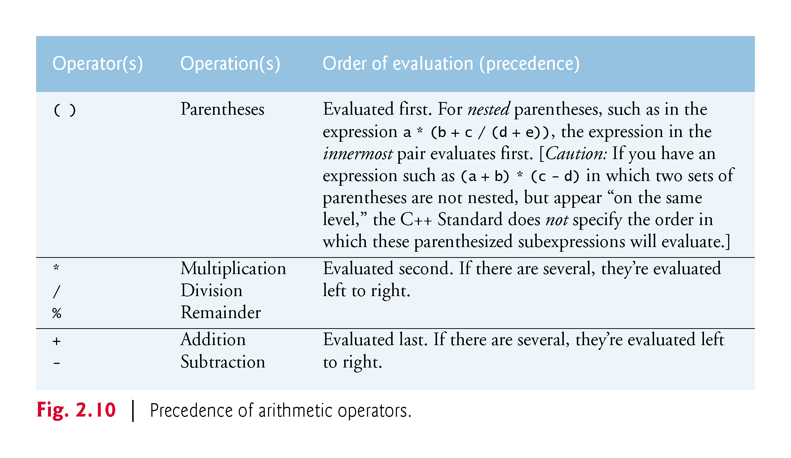

Slide 14
2.6 Arithmetic (cont.)
There is no arithmetic operator for exponentiation in C++, so x² is represented as x * x.
Figure 2.11 illustrates the order in which the operators in a second-degree polynomial are applied.
As in algebra, it’s acceptable to place redundant parentheses in an expression to make the expression clearer.

Slide 15
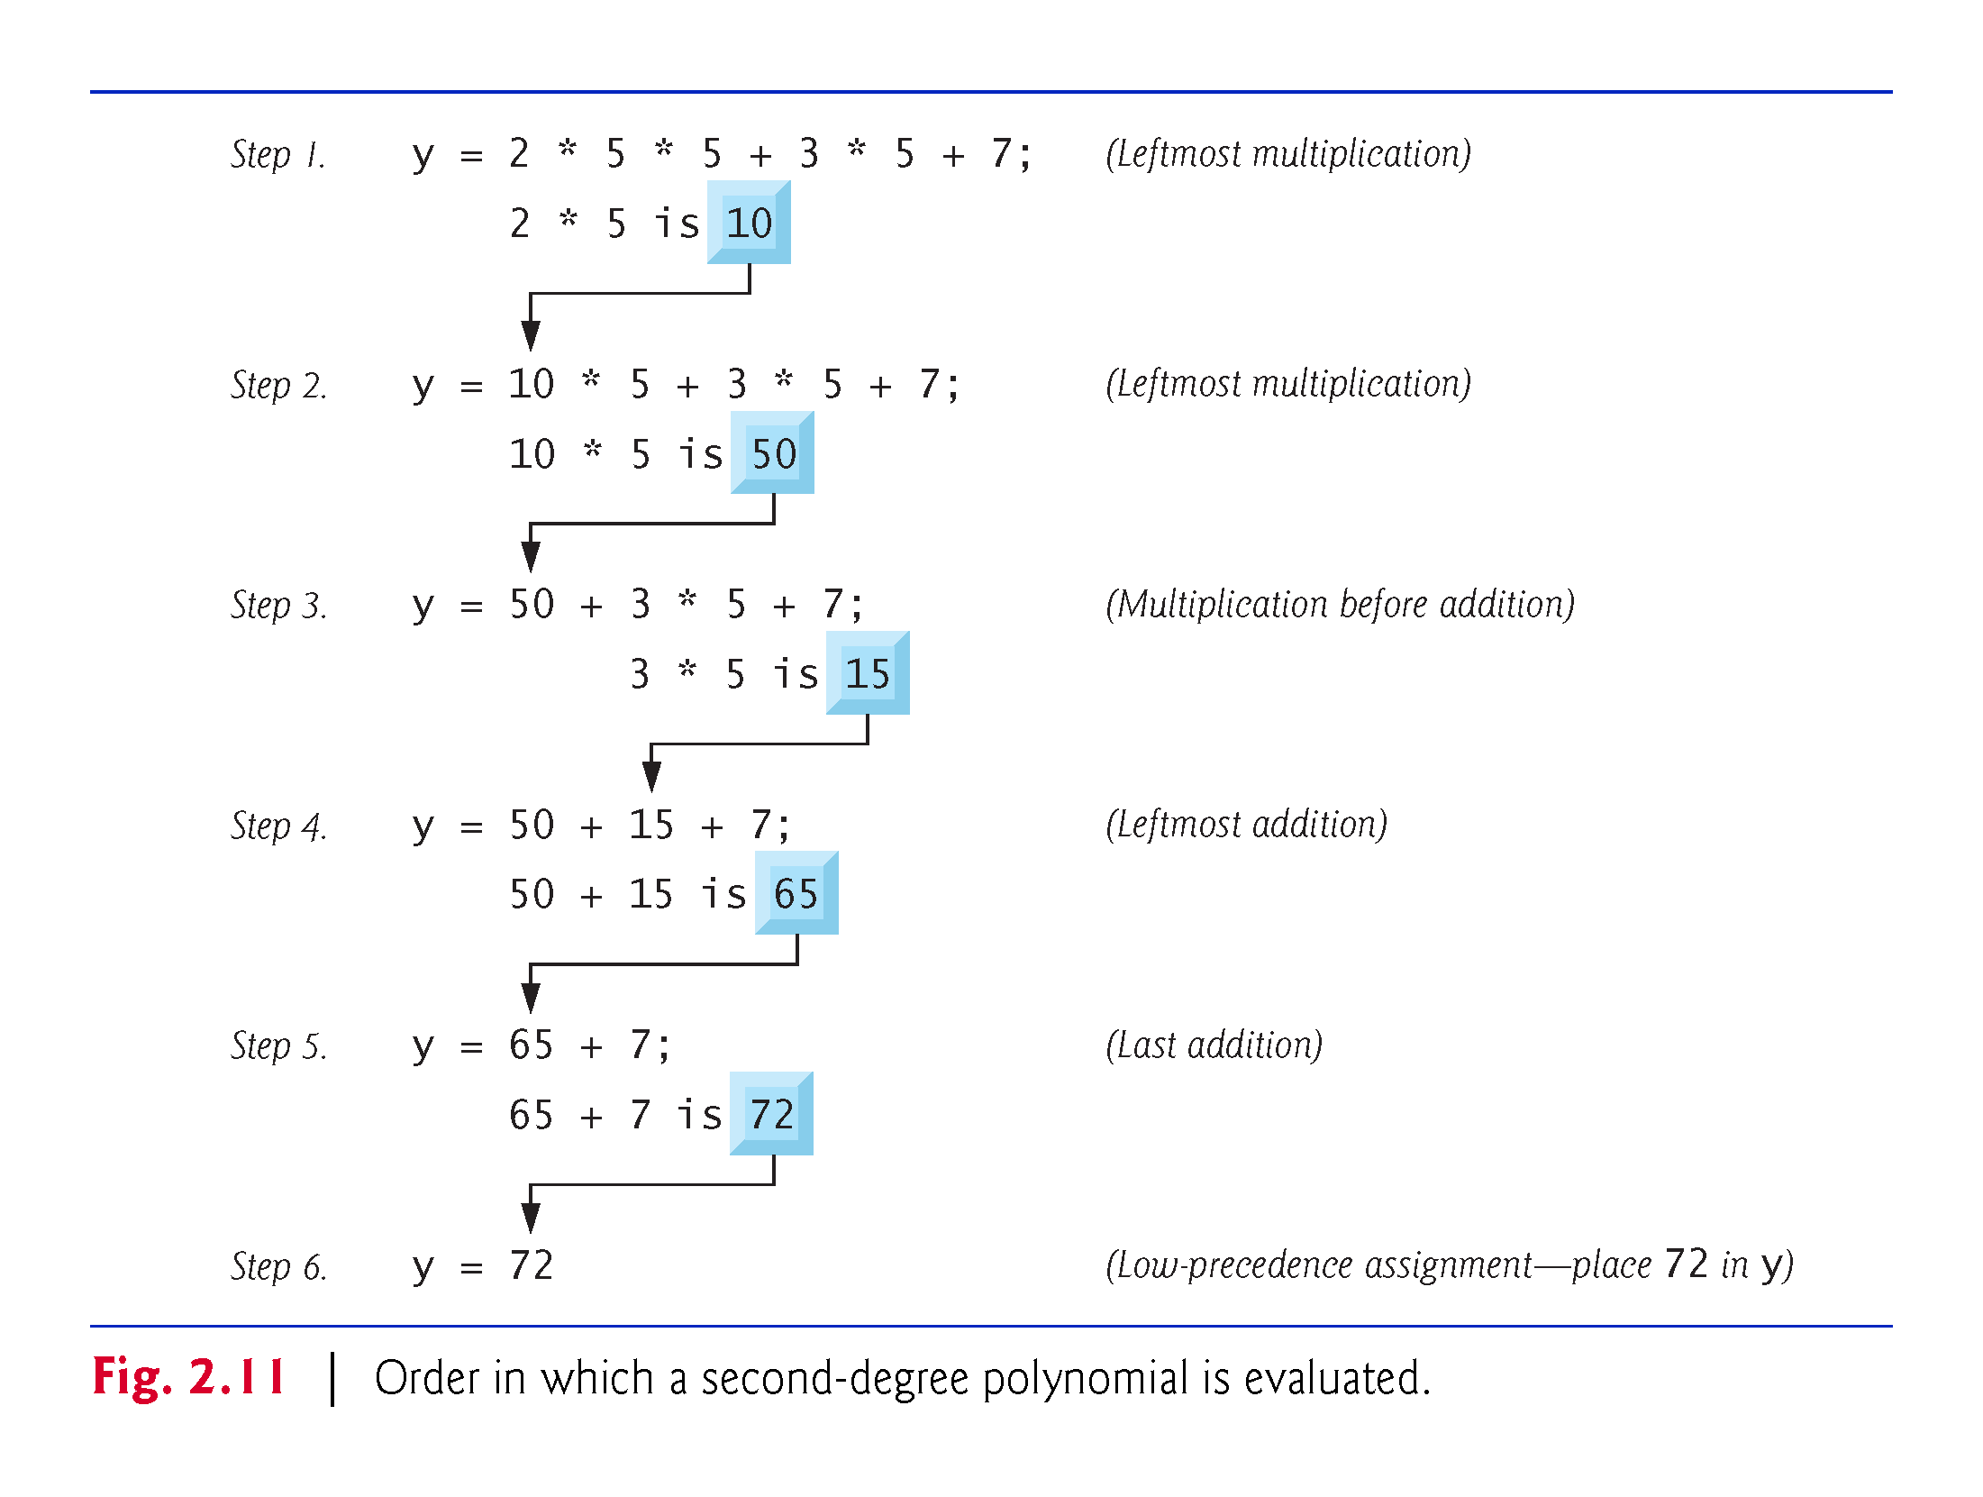

Slide 16
2.7 Decision Making: Equality and Relational Operators
The if statement allows a program to take alternative action based on whether a condition is true or false.
If the condition is true, the statement in the body of the if statement is executed.
If the condition is false, the body statement is not executed.
Conditions in if statements can be formed by using the equality operators and relational operators (Fig. 2.12).
The relational operators all have the same level of precedence and associate left to right.
The equality operators both have the same level of precedence, which is lower than that of the relational operators, and associate left to right.

Slide 17
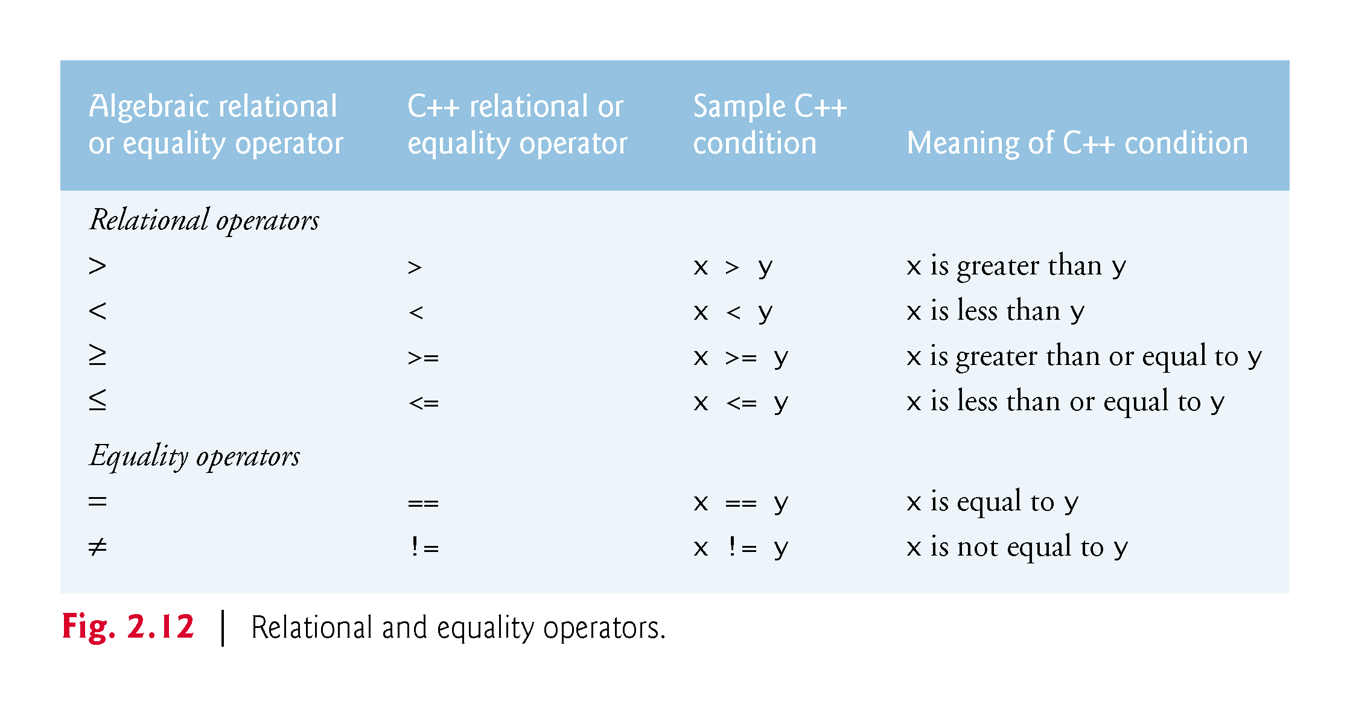

Slide 18
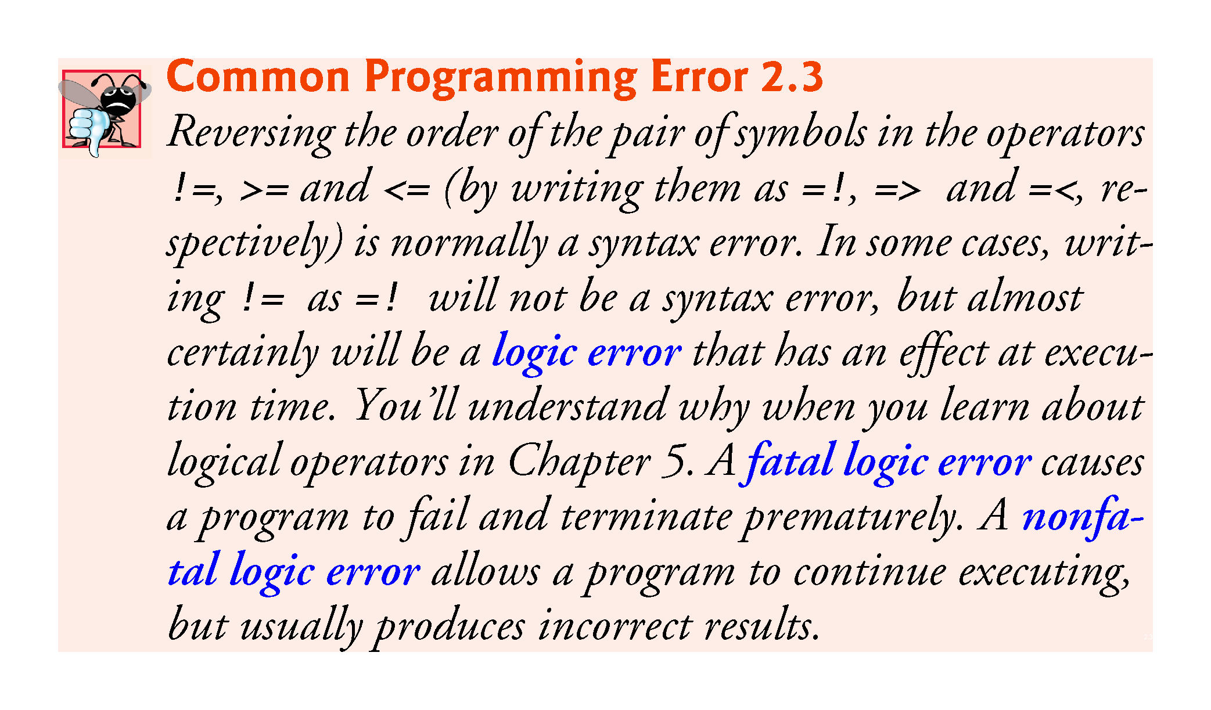

Slide 19
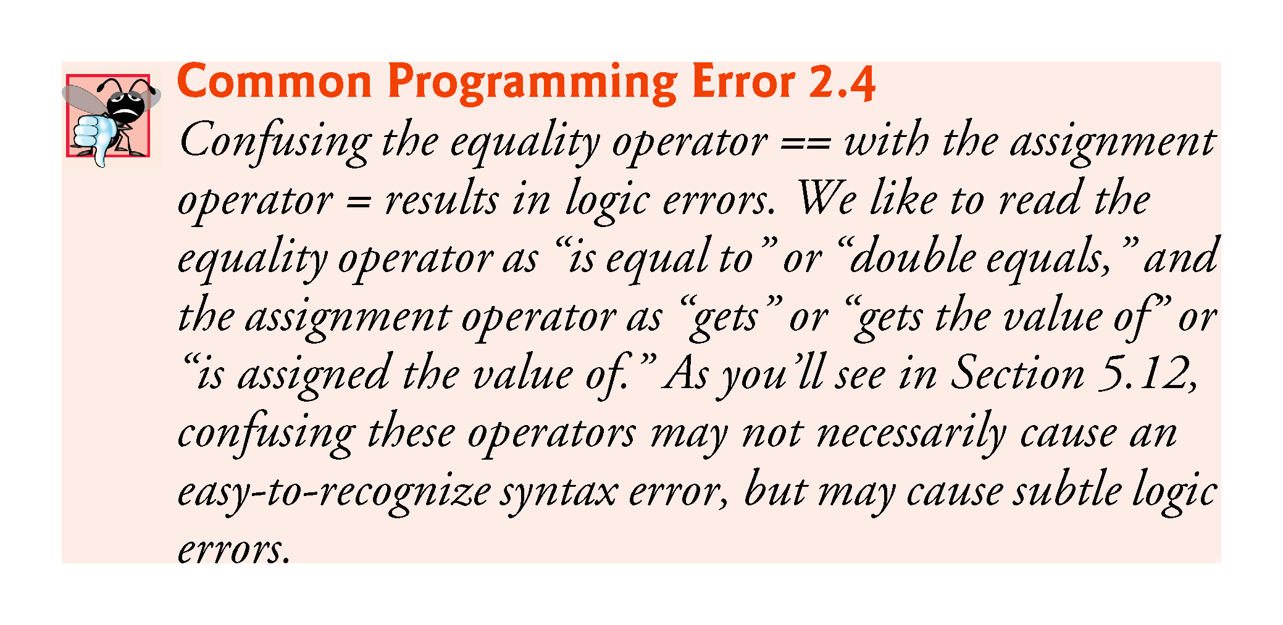

Slide 20
2.7 Decision Making: Equality and Relational Operators (cont.)
Fig. 2.12 uses six if statements to compare two numbers input by the user.
If the condition in any of these if statements is satisfied, the output statement associated with that if statement executes.
Figure 2.13 shows the program and the input/output dialogs of three sample executions.

Slide 21
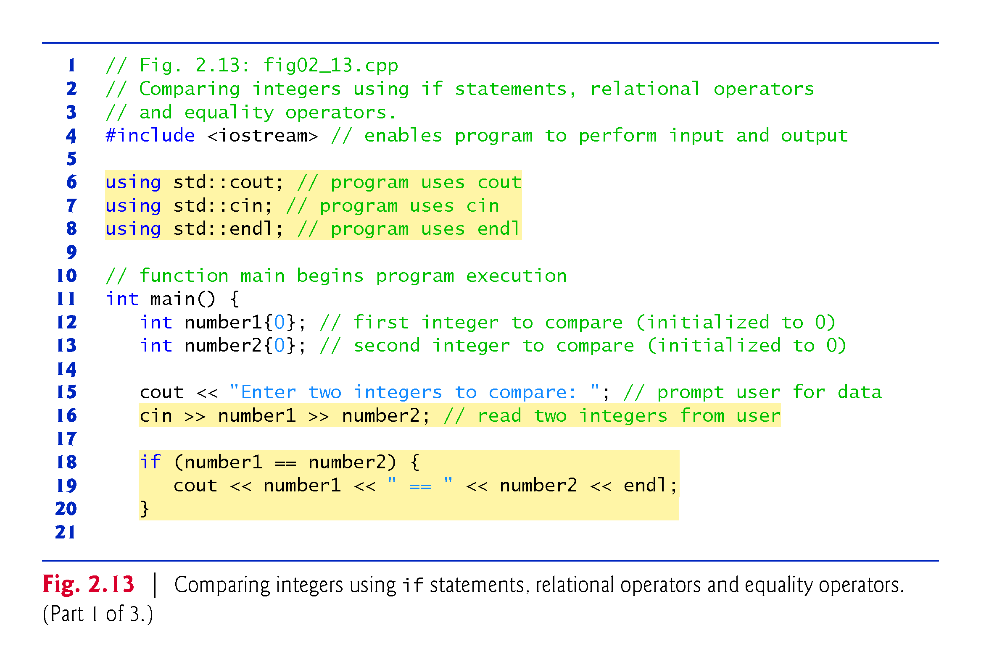

Slide 22
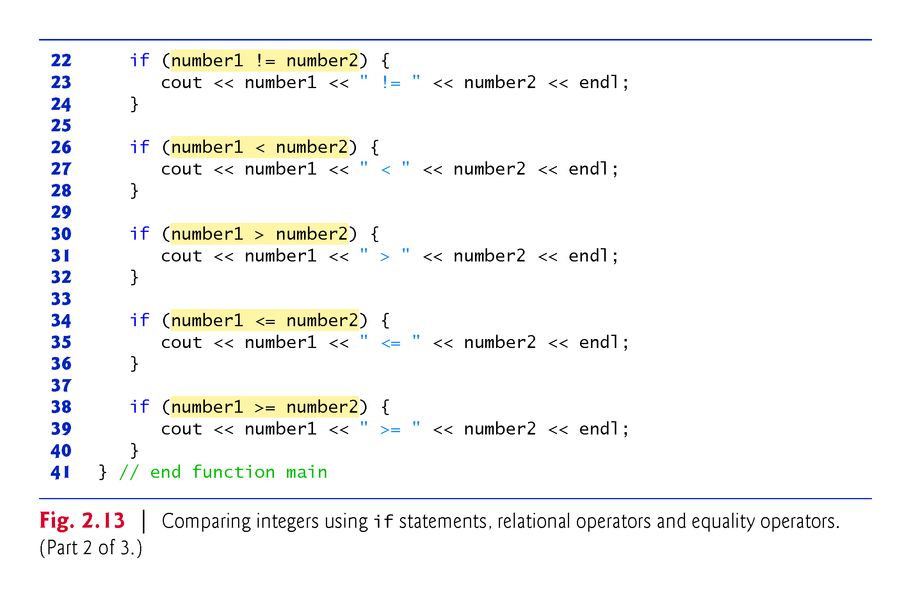

Slide 23
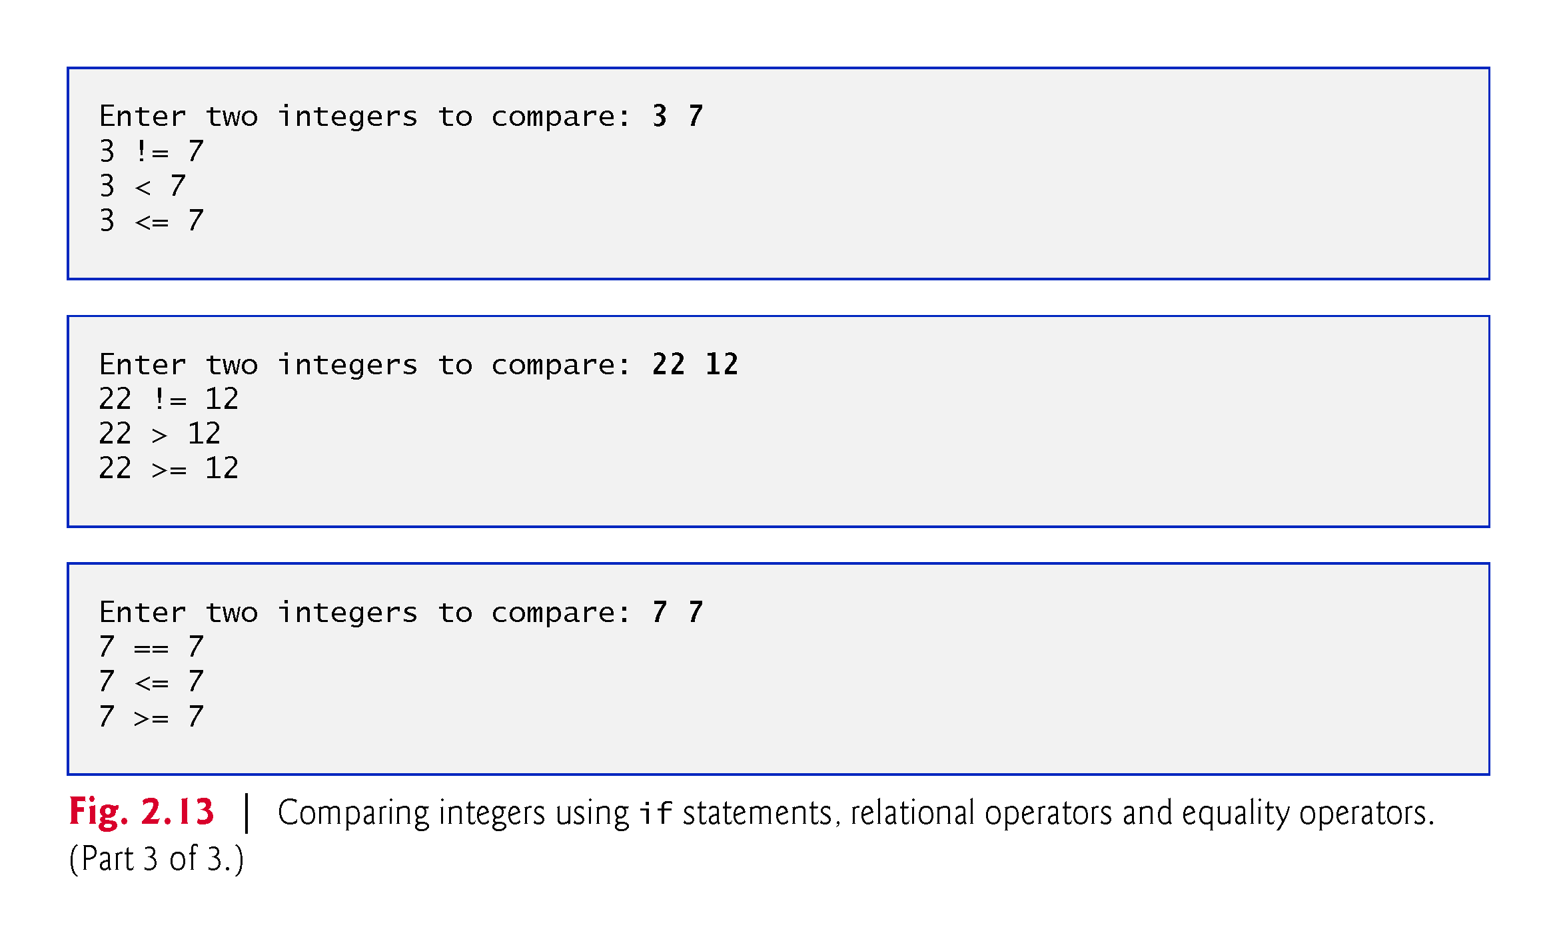

Slide 24
2.7 Decision Making: Equality and Relational Operators (cont.)
using declarations eliminate the need to repeat the std:: prefix.
Can write cout instead of std::cout, cin instead of std::cin and endl instead of std::endl, respectively, in the remainder of the program.
Many programmers prefer to use the declaration
using namespace std;
which enables a program to use all the names in any standard C++ header file (such as <iostream>) that a program might include.
From this point forward in the book, we’ll use the preceding declaration in our programs.

Slide 25
2.7 Decision Making: Equality and Relational Operators (cont.)
Each if statement in Fig. 2.13 has a single statement in its body and each body statement is indented.
Each if statement’s body is enclosed in a pair of braces, { }, creating what’s called a compound statement or a block that may contain multiple statements.

Slide 26


Slide 27
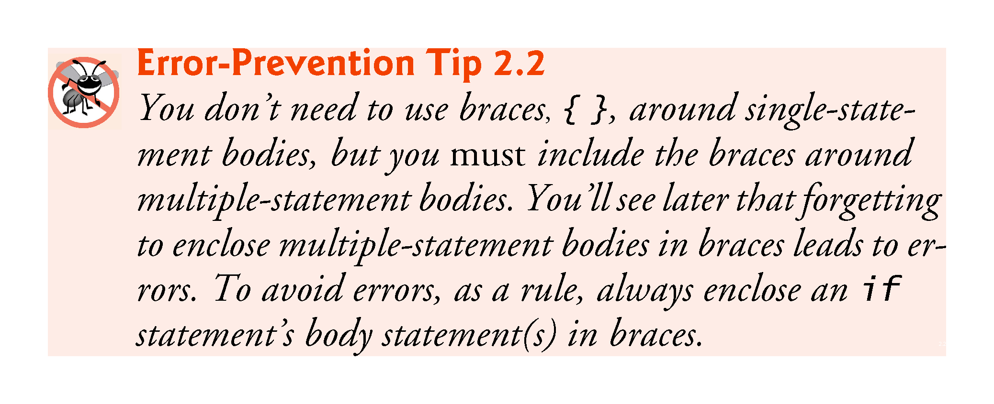

Slide 28
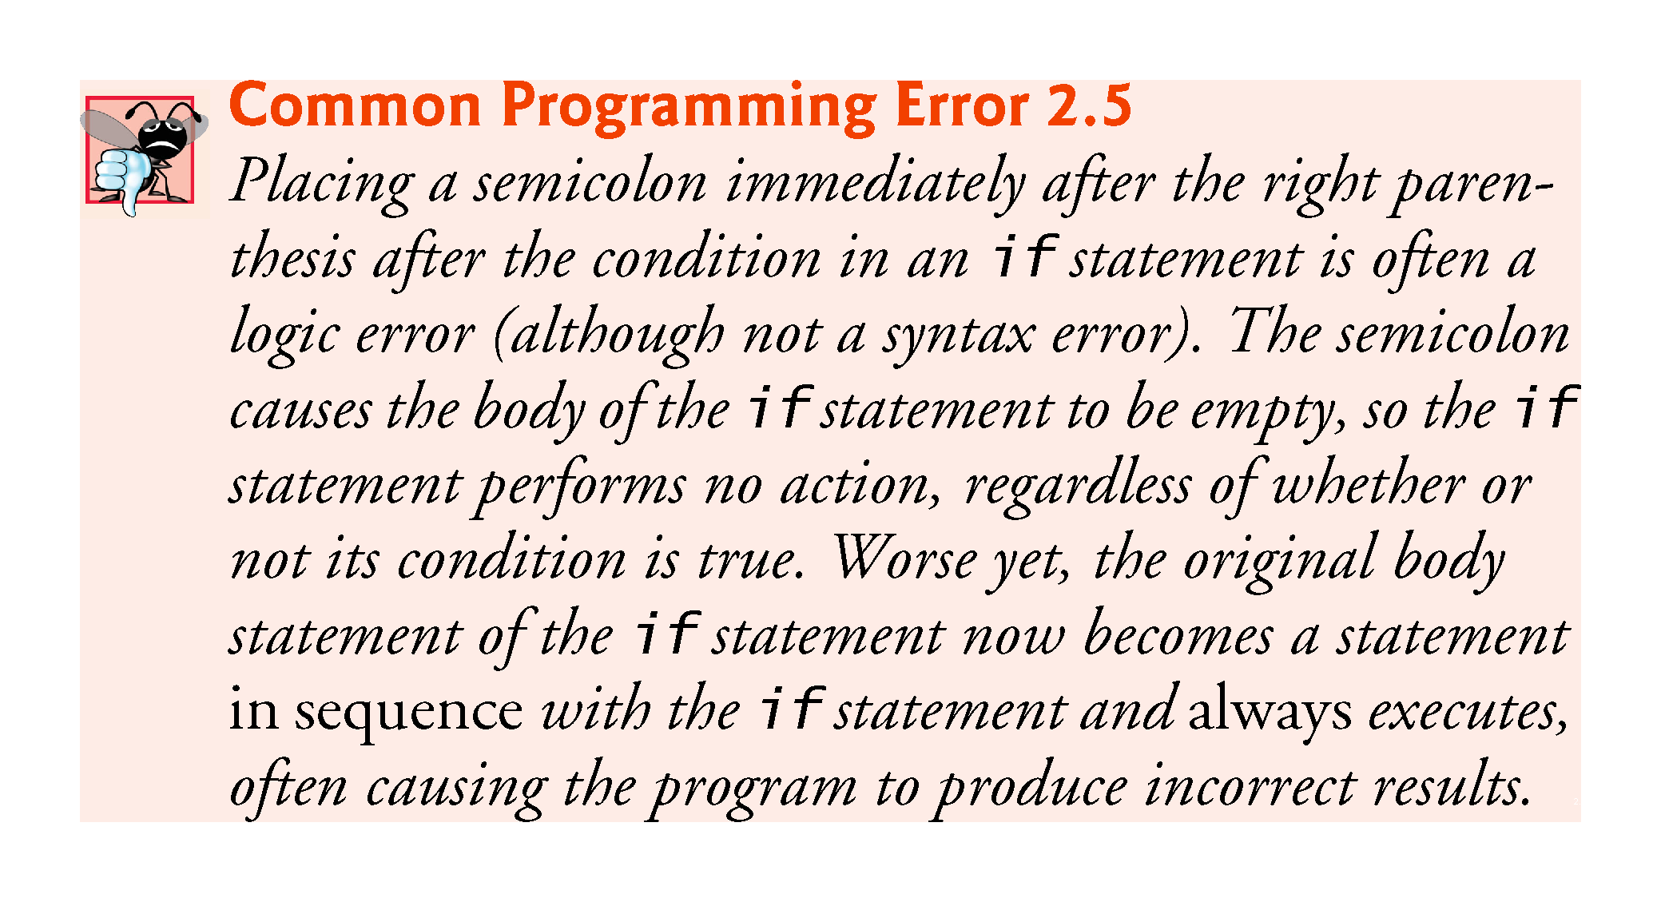

Slide 29
2.7 Decision Making: Equality and Relational Operators (cont.)
Statements may be split over several lines and may be spaced according to your preferences.
It’s a syntax error to split identifiers, strings (such as "hello") and constants (such as the number 1000) over several lines.

Slide 30
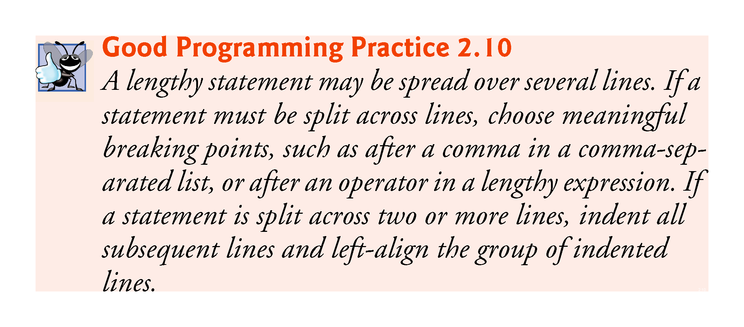

Slide 31
2.7 Decision Making: Equality and Relational Operators (cont.)
Figure 2.14 shows the precedence and associativity of the operators introduced in this chapter.
The operators are shown top to bottom in decreasing order of precedence.
All these operators, with the exception of the assignment operator =, associate from left to right.

Slide 32
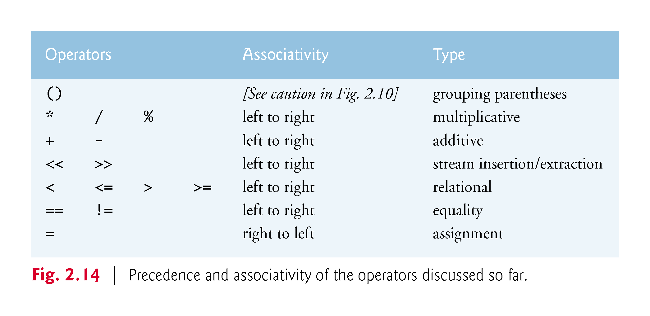

Slide 33
